Slide 1
Contiguous Memory Allocation
In the Contiguous Memory Allocation, each process is contained in a single contiguous section of memory. In this memory allocation, all the available memory space remains together in one place which implies that the freely available memory partitions are not spread over here and there across the whole memory space.
In Contiguous memory allocation which is a memory management technique, whenever there is a request by the user process for the memory then a single section of the contiguous memory block is given to that process according to its requirement. Contiguous Memory allocation is achieved just by dividing the memory into the fixed-sized partition.
The memory can be divided either in the fixed-sized partition or in the variable-sized partition in order to allocate contiguous space to user processes.

Slide 2
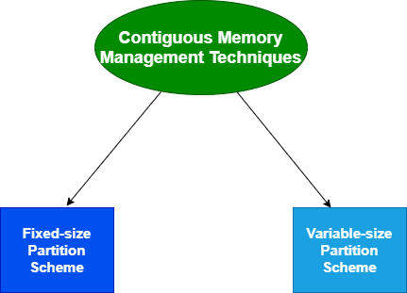

Slide 3
Fixed-size Partition Scheme
This technique is also known as Static partitioning.
In this scheme, the system divides the memory into fixed-size partitions.
The partitions may or may not be the same size.
The size of each partition is fixed as indicated by the name of the technique and it cannot be changed.
In this partition scheme, each partition may contain exactly one process.
There is a problem that this technique will limit the degree of multiprogramming because the number of partitions will basically decide the number of processes.
Whenever any process terminates then the partition becomes available for another process.

Slide 4
Internal fragmentation
Limit in process size
Limitation on degree of multiprogramming
External fragmentation

Slide 5
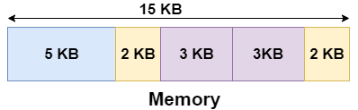
Example
Let's take an example of fixed size partitioning scheme, we will divide a memory size of 15 KB into fixed-size partitions:
It is important to note that these partitions are allocated to the processes as they arrive and the partition that is allocated to the arrived process basically depends on the algorithm followed.
If there is some wastage inside the partition then it is termed Internal Fragmentation.

Slide 6
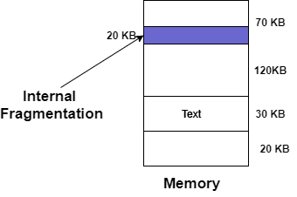

Slide 7
Variable-size Partition Scheme
This scheme is also known as Dynamic partitioning and is came into existence to overcome the drawback i.e internal fragmentation that is caused by Static partitioning. In this partitioning, scheme allocation is done dynamically.
The size of the partition is not declared initially.
Whenever any process arrives, a partition of size equal to the size of the process is created and then allocated to the process.
Thus the size of each partition is equal to the size of the process.
As partition size varies according to the need of the process so in this partition scheme there is no internal fragmentation.

Slide 8
No internal fragmentation
No limitation on number of processes

Slide 9
